Slide 1
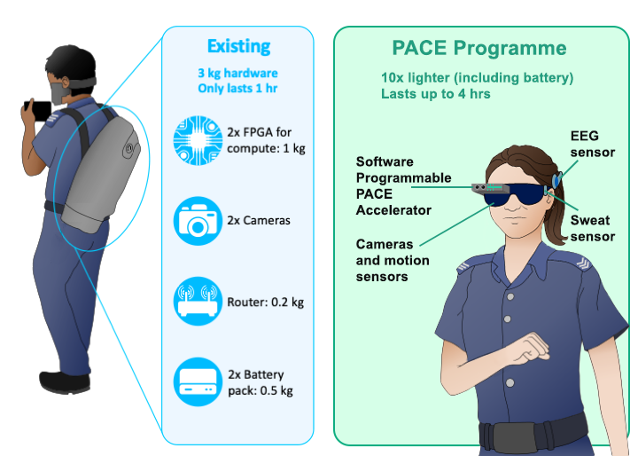
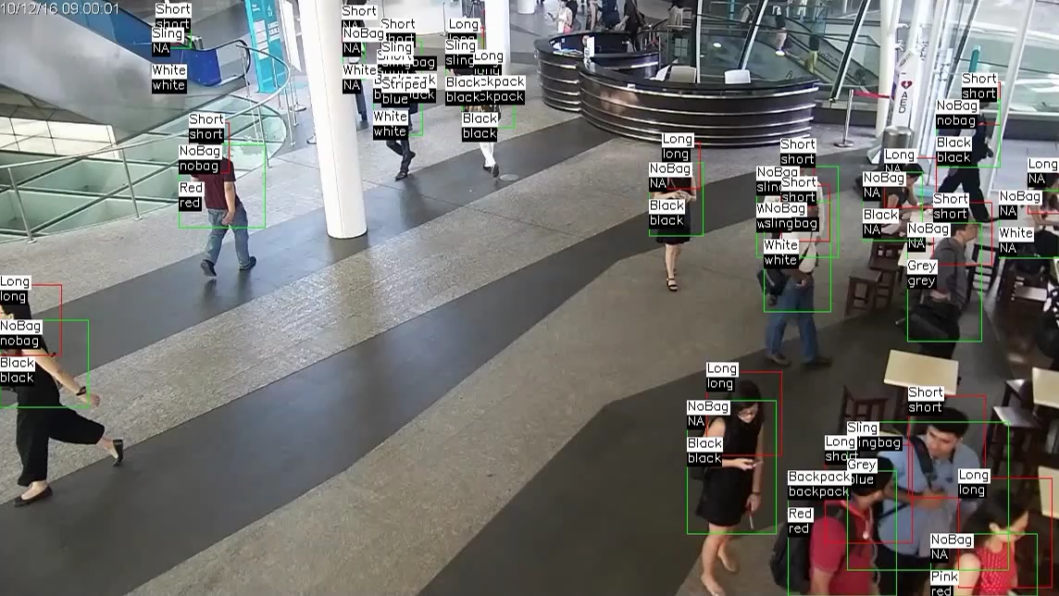
PACE: Enabling Multisensory Edge Analytics
Real-time event analytics
for Singapore police
Circa: 2019
Circa: 2025
Mixed-reality event analytics for police
Multimodal-multisensor interface
Emotional, physiological state monitoring
Orientation, position monitoring
Beyond deep neural networks
Machine vision: scene understanding
Navigation via visual-inertial odometry
Continuous biometrics
PACE: 2 TOPS/Watt software programmable accelerator for intensive edge computing

Slide 2
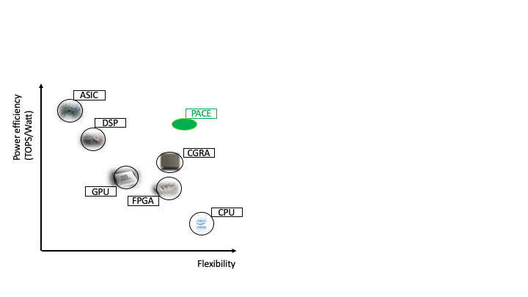
Edge Computing Hardware Landscape
Existing solutions are either inefficient (CPU, GPU, FPGA) or specialized (Google TPU, MIT Eyeriss)
Multimodal-multisensory analytics on IoT edge device requires general-purpose efficient accelerator
 | Performance | Power | Versatility | Programmability
ASIC Accelerator
CPU
GPU
FPGA
PACE
ASIC from top Conf. from ’16 to ‘20
Eyeriss
TPU
Gesture recognition requires < 8ms
Tiny CPU: 577ms, 9 mW Smartphone CPU: 13ms, 469 mW
NUS HyCUBE CGRA: 7ms, 100mW
PACE
Final
TOPS/W
HyCUBE
FPGA
PACE: Software-programmable accelerator to achieve the efficiency of today’s specialized accelerators
ARM CPU
Year

Slide 3
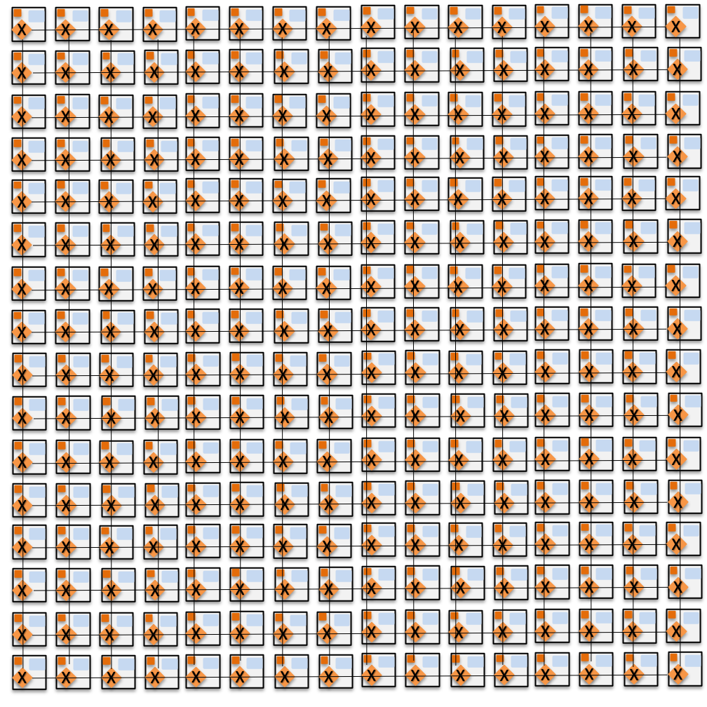
PACE Innovation: Dataflow computing
Move from sequential to parallel dataflow model
Parallelism is fully exposed at software level
Past dataflow architectures did not succeed as complex hardware determined when an instruction would execute
PACE: Dataflow computing with a twist
Simple, parallel hardware: low power, high performance
Smart software compiler spells out spatio-temporal schedule of instructions completely

Slide 4
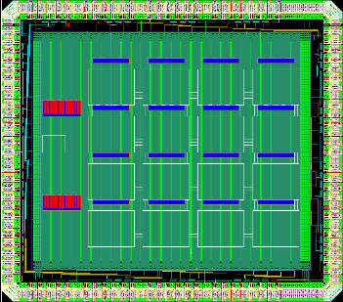
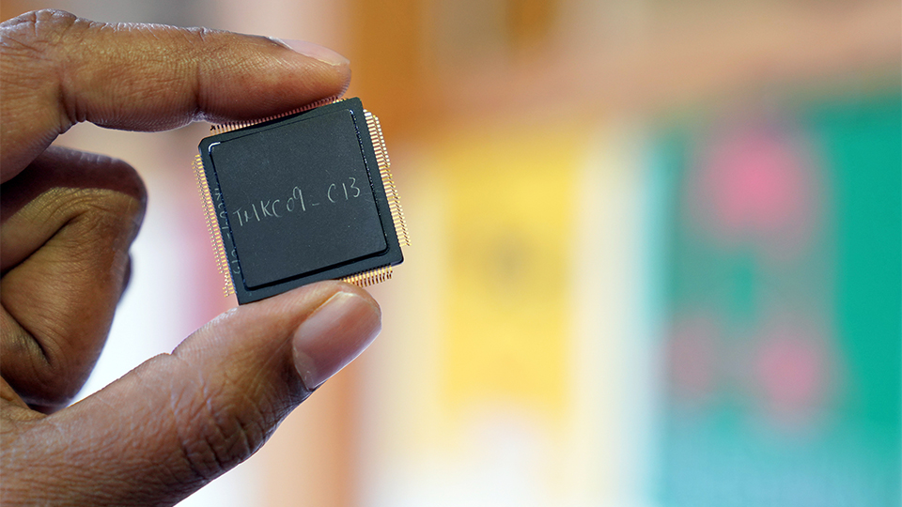
Pace Innovation: Let Software Define Hardware
Embrace Parallelism
Simple Hardware
Expose to Software
+
+
Time 0
F0
F1
F0
F1
F2
F3
*
<<
*
<<
Time 1
F0
F1
F2
F3
F2
F3
-
-
Time 2
F0
F1
F2
F3
Coarse-Grained Reconfigurable Array (CGRA) at NUS
Top international CGRA research group: PI Mitra, Peh
Award-winning theoretically optimal CGRA Compiler
Edge CGRA with highest compute-efficiency
Software-Defined Hardware Programme
Poor compiler
Server vs. edge
Hardware vs. systems
Samsung Reconfigurable Processor
Configurable
Spatial Accelerator

Slide 5
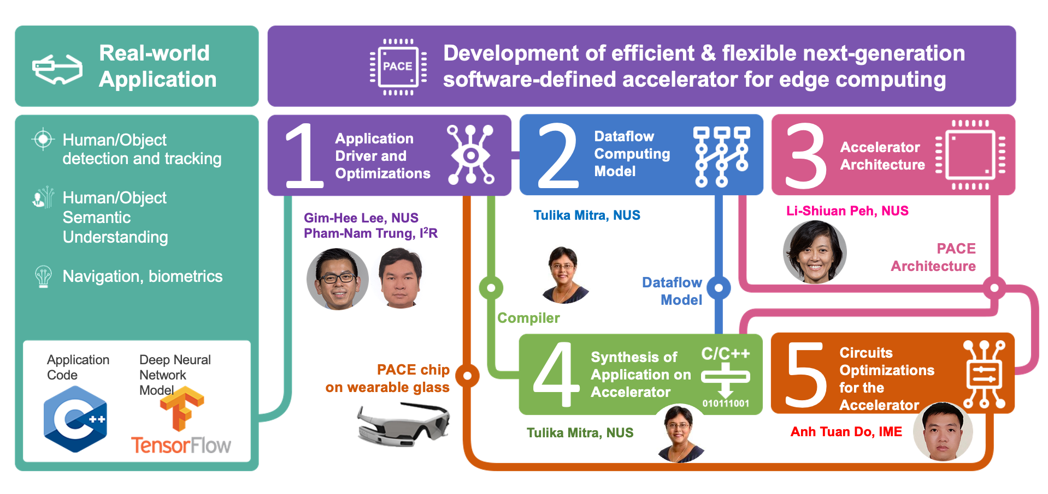
PACE Programme: A synergistic Cross-Layer Approach
Significant innovations in architecture, compiler, application optimizations to realize the software-defined edge accelerator vision
Fully functional software-defined Coarse-Grained Reconfigurable Array (CGRA) accelerator chip with the highest energy efficiency
World’s first end-to-end software development framework for CGRAs with best quality mapping and shortest compilation time
Demonstration of complete edge analytics applications (speech and gesture recognition) on PACE SoC development platform

Slide 6
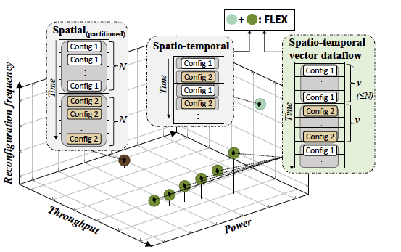
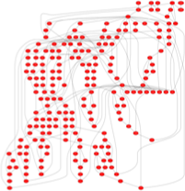
PACE: Software-Programmable CGRA Accelerator
Dataflow Computing: Let Software Define Hardware
Dataflow Graph (DFG) of application
CGRA (Coarse-Grained Reconfigurable Array)
Spatio-temporal mapping of DFG on CGRA
PACE CGRA accelerator moves away from traditional sequential von Neumann model to inherently parallel dataflow computing model
The hardware is a simple, low-power processing element (PE) array with small context memory to store limited reconfiguration information
Compiler maps application dataflow graph (DFG) onto CGRA using per-cycle reconfiguration of compute and on-chip network
PACE 1.0 accelerator chip achieves the highest energy efficiency among state-of-the-art CGRAs: 360 GOPS/W, 4.4mW at 0.6V, 40nm (measured) & 582 GOPS/W, 1.1mW at 0.45V (simulated, measurement on silicon in progress) through aggressive hardware-software codesign, power management of idle PEs, architectural innovations (single-cycle multi-hop network, software-defined memory hierarchy etc.)

Slide 7
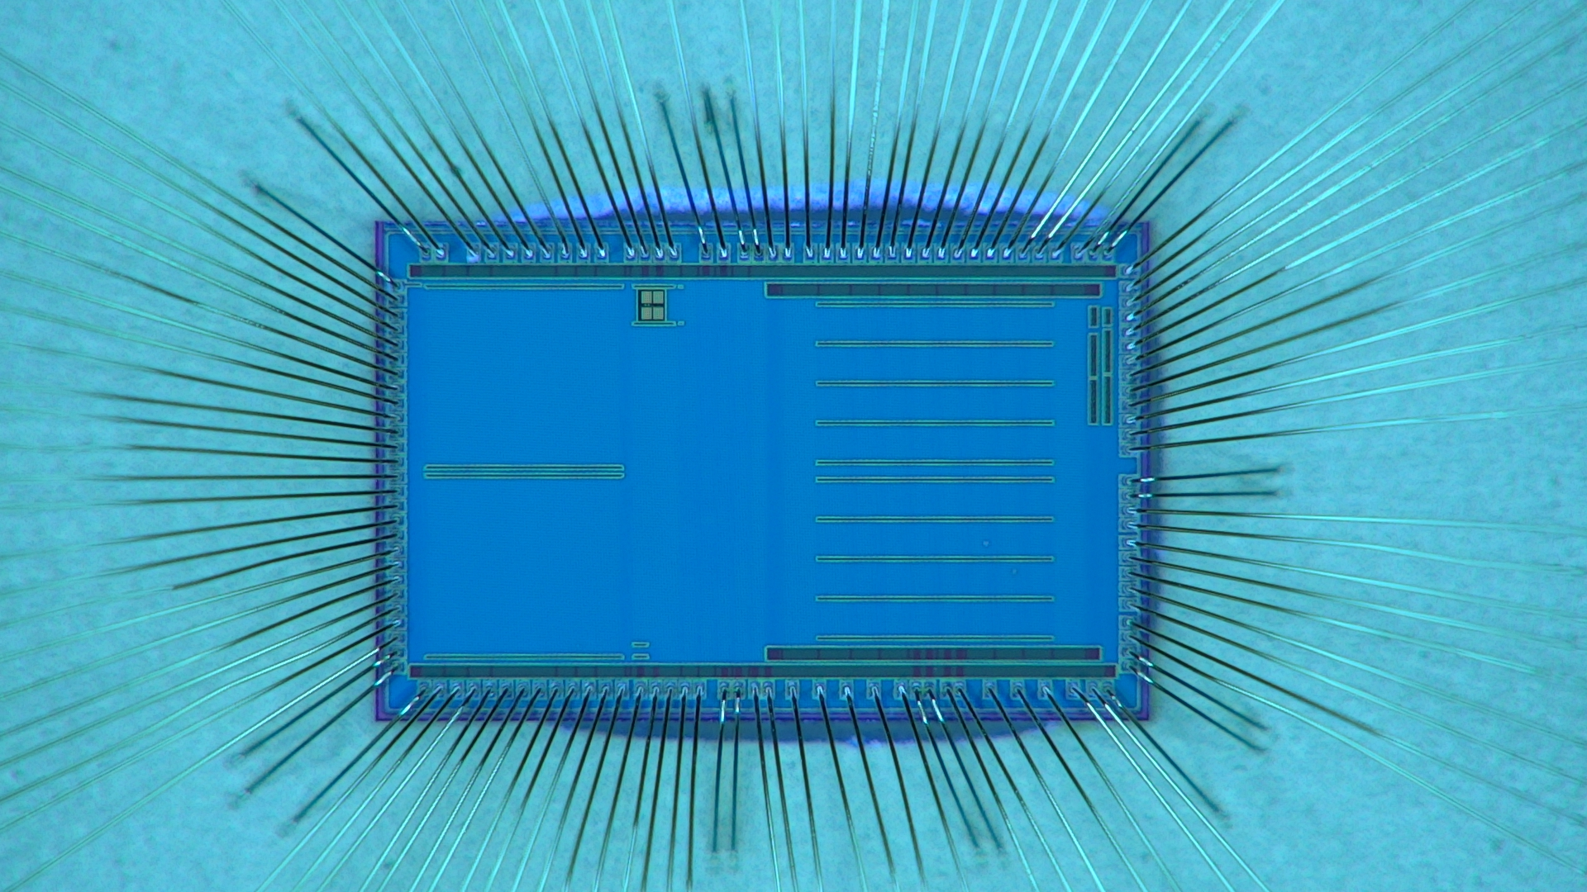
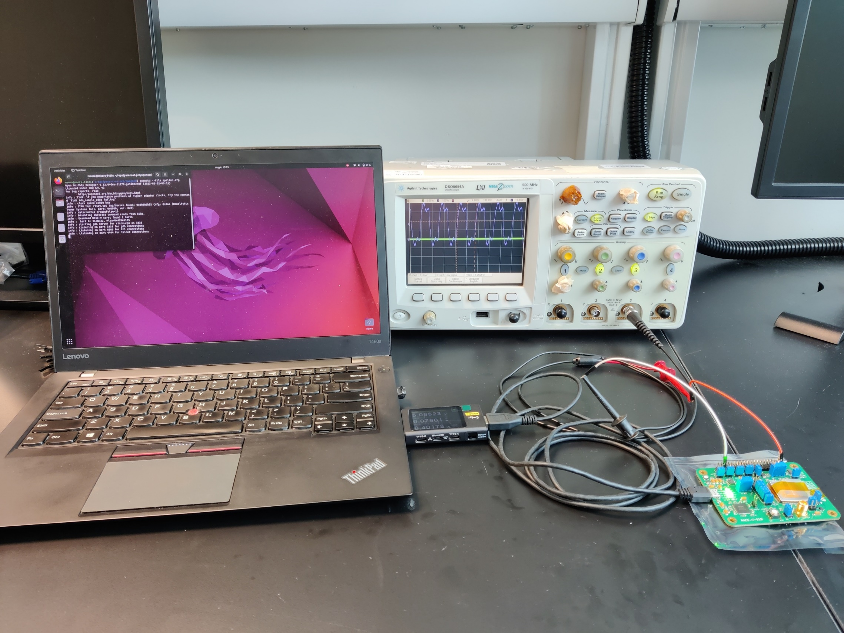
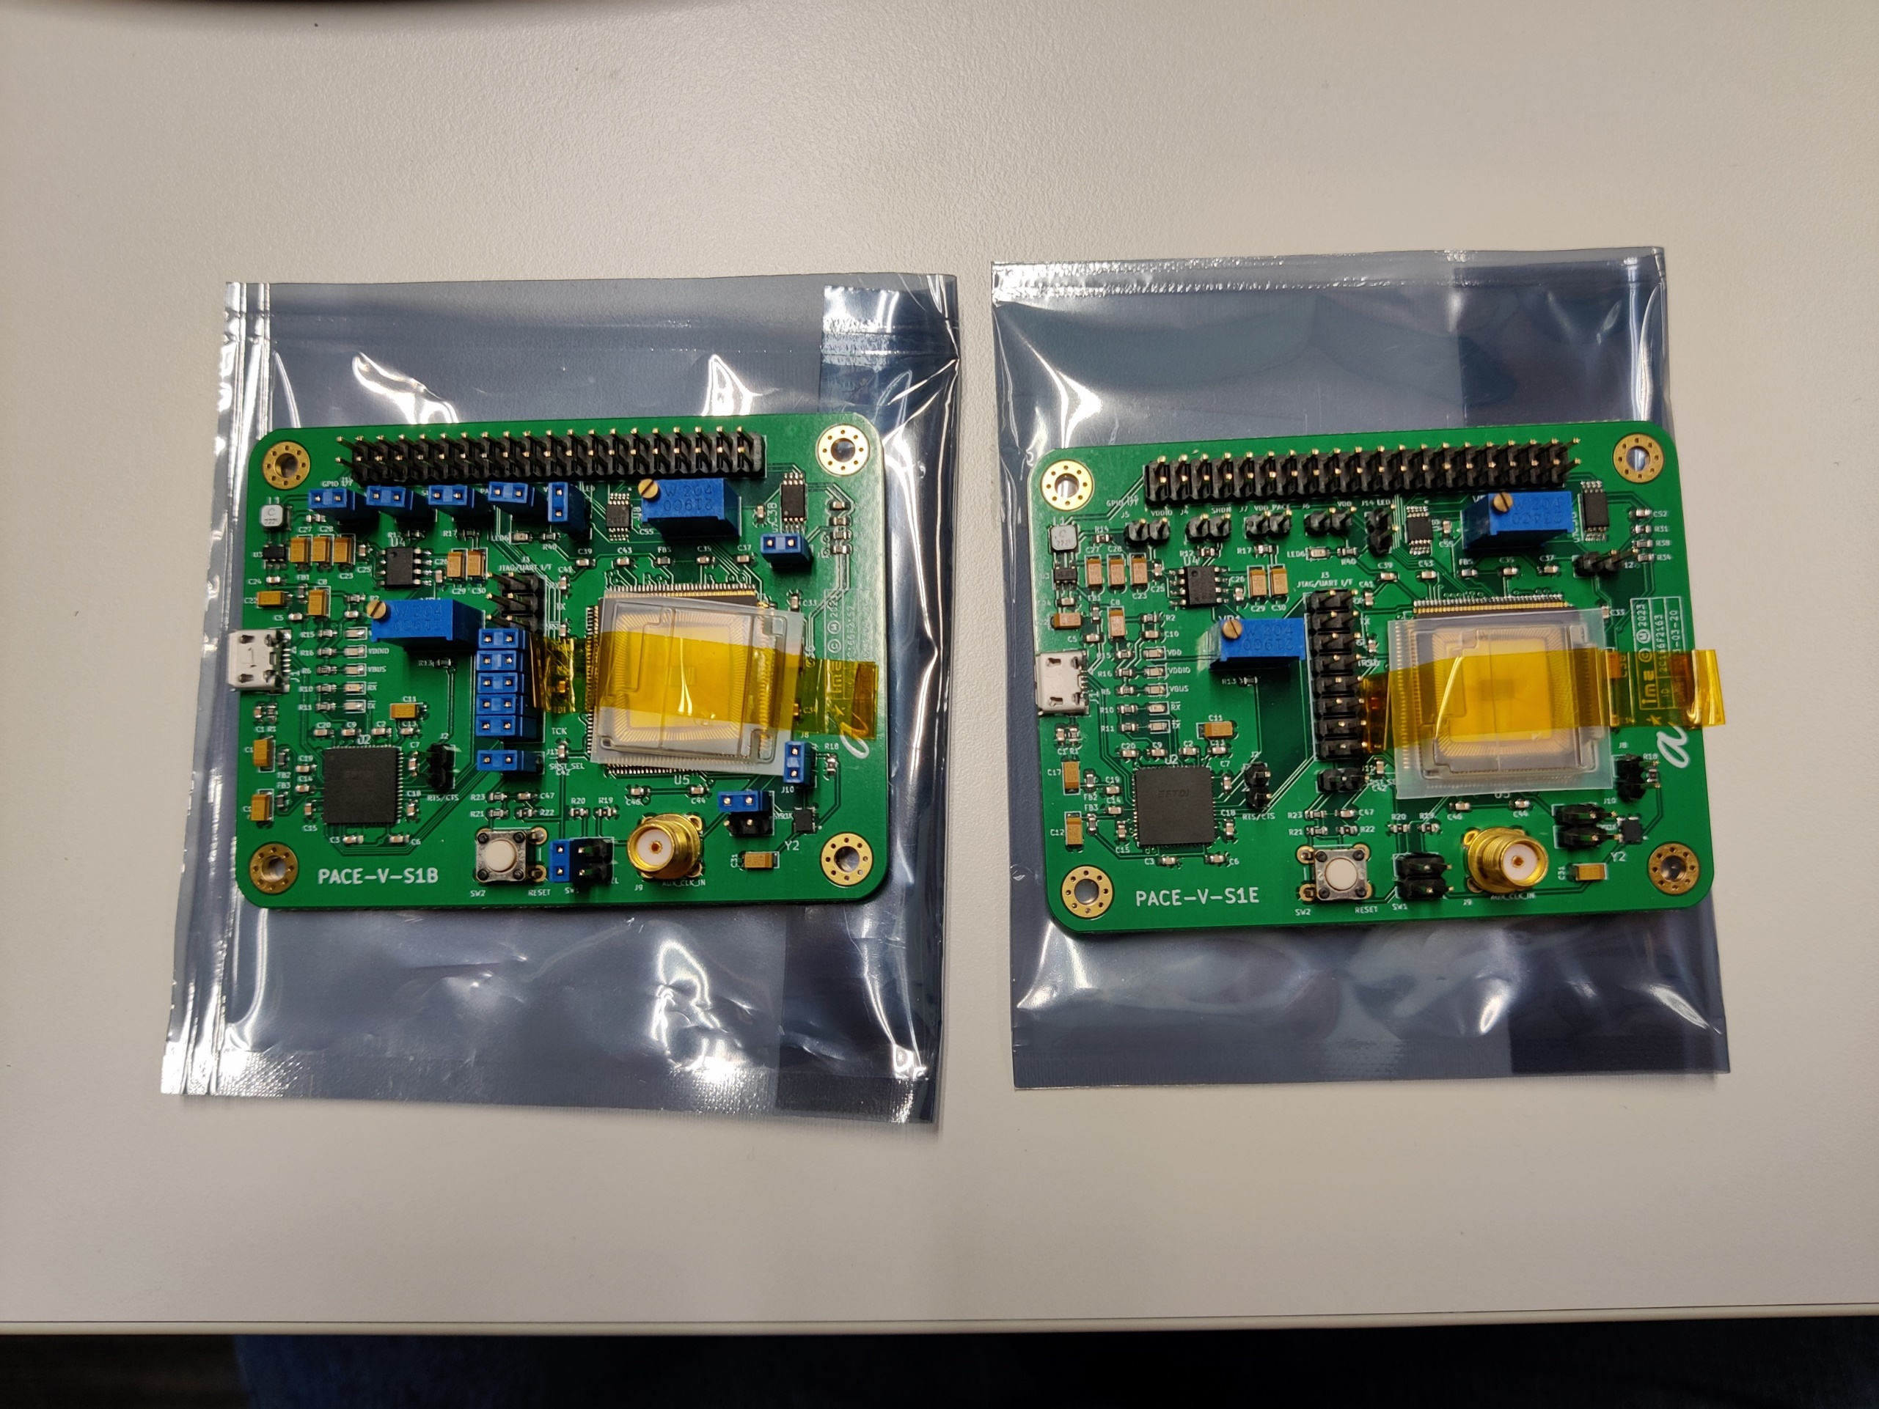
Hardware: 64-PE CGRA SoC with RISC-V controller
We successfully designed, optimized and integrated our CGRA accelerator with a low-power RISC-V controller to create a complete system-on-chip (SoC) solution
The SoC chip was designed and fabricated in 40nm CMOS process.
System-on-chip
3.96mm
RISC-V based CPU
SDRAM core
RISC-V based controller
CGRA data memory
8x8 PE array
CGRA data memory
16KB D$
16KB I$
512KB on-chip SRAM
Interconnects
2.4 mm
CGRA
8×8 PE array
8x8KB data memory (DM)
Peripheral subsystem
CGRA
8KB DM
PE
PE
…
PE
PE
8KB DM
Chip micrograph
Test set-up
PE
PE
…
PE
PE
Design techniques
Light-weight ALU (17 instructions)
Configurable router supporting single-cycle multi-hop transfer.
Static clock gating can be applied when inactive PEs are known beforehand, saving 70% power
Dynamic clock gating by NOP instructions → 10.8% power reduction
Block-based back-end implementation → improve timing closure, clock tree power
8KB DM
PE
PE
…
PE
PE
8KB DM
PE
PE
…
PE
PE
CGRA Controller
8KB DM
PE
PE
…
PE
PE
8KB DM
PE
PE
…
PE
PE
8KB DM
PE
PE
…
PE
PE
8KB DM
PE
PE
…
PE
PE
PACE assembled on PCB board
CGRA Integrated in SoC

Slide 8
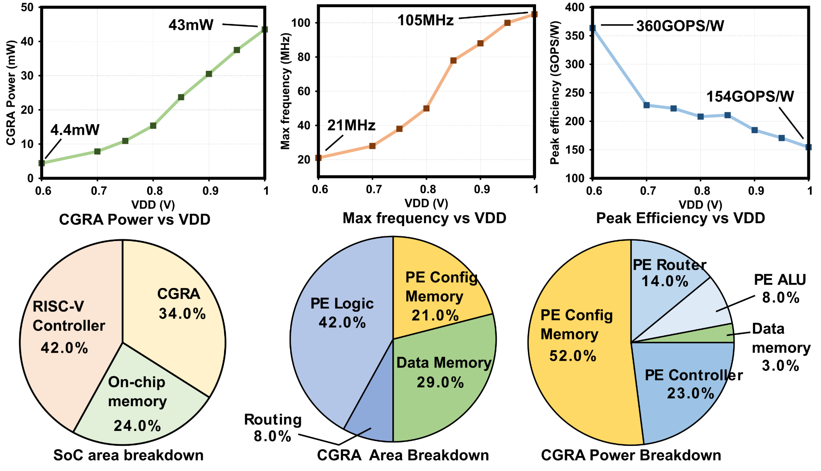
Hardware Evaluation: Measured 360 GOPS/W at 0.6 V, 21 MHz
The whole SoC showed full functionalities when running micro-sized speech kernels with the supply voltage from 0.6V-1.2V.
At 0.6V the CGRA accelerator consumes only 4.4 mW @ 21 MHz, offering an energy efficiency of 360 GOPS/W
Work-in-progress to measure expected energy efficiency of 582 GOPS/W at 0.45V resulting in 1.1mW @ 10 MHz
Breakdown of the power and area consumption of our fabricated chip are also shown below. Within the PE array, the configuration memory is the most power-hungry block because it is read-out every cycle to control the next operation of the ALU and the router.
Chip measurement results

Slide 9
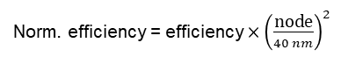

Benchmarking against the state of the arts
The whole SoC showed full functionalities when running micro-sized speech kernels with the supply voltage from 0.6V-1.2V.
PACE achieves 1.2x better efficiency as compared to the state-of-the-art
At 0.6 V, 4.4mW @ 21 MHz, it offers the best measured peak energy efficiency of 360 GOPS/W. Our simulation shows that the chip can achieve 582 GOPS/W at 0.45V, 1.1mW @ 10MHz. Further test are still on-going towards this goal. This is equivalent to > 1 TOPS/W at 22nm or 28nm CMOS.
In the next tape-out, we are planning to move to 28nm CMOS to better achieve the final goal of the program (i.e., 2 TOPS/W)
 | Amber [1] | SSCL [2] | ISSCC [3] | TVLSI [4] | Hycube [5] | Snafu [6] | RipTide [7] | JSSC [8] | This work (measured) | This work (simulated)
Year | 2022 | 2020 | 2019 | 2018 | 2019 | 2021 | 2022 | 2020 | 2023 | 2023
Tech (nm) | 16 | 28 | 22 | 55 | 40 | 28 | 22 | 28 | 40 | 40
CGRA area (mm²) | 20.1 | 3.9 | 4.9 | 5.19 | 2.87 | 1.0 | 0.25 | 4.80 | 3.02 | 3.02
#PEs | 384 | 120 | 15 | 30 | 16 | 36 | 36 | 64 | 64 | 64
Voltage (V) | 1.29 | 0.9 | 0.8 | -- | 1.1 | N/A | N/A | 0.9 | 1.0/0.6 | 1.0/0.45
Freq (MHz) | 955 | 89 | 36 | 450 | 853 | 50 | 50 | 800 | 100 21@0.6V | 100 10@0.45V
Throughput (GOPS) | 367 (INT16) | 14.1 | 145 | 77.4 | 6.48 | N/A | 62 | 0.88 | 64 | 64
Power (mW) | N/A | 45.9 | N/A | 1526 | 72 | 0.32 | 0.24 | 537 | 43@1V 4.4@0.6V | 43@1V 1.1@0.45V
Efficiency (GOPS/W) | 538@ 1.29V (INT16) | 307@ 0.9V | 978@0.48V | 50.8 | 90 | 305 | 254 | 196 | 154@1V 360@0.6V | 582@0.45V
Memory | 4500KB | 234KB | 690KB | 54KB | 7KB | 256KB | 256KB | 320KB | 80KB | 80KB
Norm. area (mm²) | 50 | 5.5 | 3.2 | 3.67 | 2.87 | 2.0 | 1.0 | 6.86 | 3.02 | 3.02
Norm. area per PE (mm²) | 0.13 | 0.05 | 0.21 | 0.12 | 0.18 | 0.06 | 0.03 | 0.11 | 0.05 | 0.05
Norm. efficiency (GOPS/W) | 86 | 150 | 296 | 96 | 90 | 151* | 77* | 96 | 360 | 582
Norm. efficiency = efficiency $×{\left(\frac{\text{node}}{40 nm}\right)}^{2}$
Norm. area = area $×\frac{40 nm}{\text{node}}$
* simulated
Notes:
[1] A. Carsello et al., "Amber: A 367 GOPS, 538 GOPS/W 16nm SoC with a Coarse-Grained Reconfigurable Array for Flexible Acceleration of Dense Linear Algebra," 2022 IEEE VLSI Technology and Circuits, 2022, pp. 70-71.
[2] S. Smets, et al., "A 28-nm Coarse Grain 2D-Reconfigurable Array With Data Forwarding," in IEEE SSCL, vol. 3, pp. 226-229, 2020.
[3] S. Smets, et al., "2.2 A 978GOPS/W Flexible Streaming Processor for Real-Time Image Processing Applications in 22nm FDSOI," 2019 IEEE ISSCC, 2019, pp. 44-46.
[4] X. Fan, et al., "Stream Processing Dual-Track CGRA for Object Inference," in IEEE TVLSI, vol. 26, no. 6, pp. 1098-1111, June 2018.
[5] B. Wang, et al., "HyCUBE: A 0.9V 26.4 MOPS/mW, 290 pJ/op, Power Efficient Accelerator for IoT Applications," 2019 IEEE A-SSCC, 2019, pp. 133-136.
[6] G. Gobieski, et al., "Snafu: An Ultra-Low-Power, Energy-Minimal CGRA-Generation Framework and Architecture," 2021 ACM/IEEE ISCA, 2021, pp. 1027-1040.
[7] G. Gobieski, et al., "RipTide: A Programmable, Energy-Minimal Dataflow Compiler and Architecture," 2022 IEEE/ACM MICRO, 2022, pp. 546-564.
[8] [1] G. Peng, L. Liu, S. Zhou, S. Yin, and S. Wei, “A 2.92-Gb/s/W and 0.43-Gb/s/MG Flexible and Scalable CGRA-Based Baseband Processor for Massive MIMO Detection,” IEEE Journal of Solid-State Circuits, vol. 55, no. 2, pp. 505–519, Feb. 2020.

Slide 10
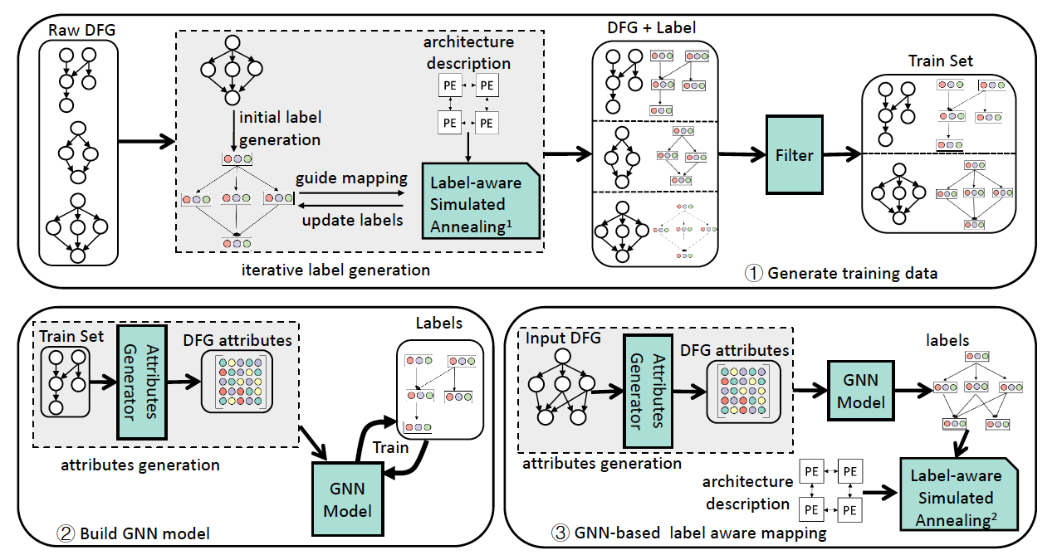
High-Quality Dataflow Synthesis on CGRA
Invented scalable and portable compiler techniques for high-quality dataflow synthesis
HiMap (TCAD 2022), Panorama (DAC 2022): Scalable mapping of regular and irregular complex dataflow on larger CGRAs through hierarchical abstractions
Mapping quality: 17x improved performance, 5x improved energy-efficiency
Reduce compilation time from days to 15-mins
LISA (HPCA 2022): Automated compiler generation on any new spatial accelerator architecture using graph neural network (GNN)
Better mapping quality than hand-crafted compiler, 17x reduction in compilation time

Slide 11

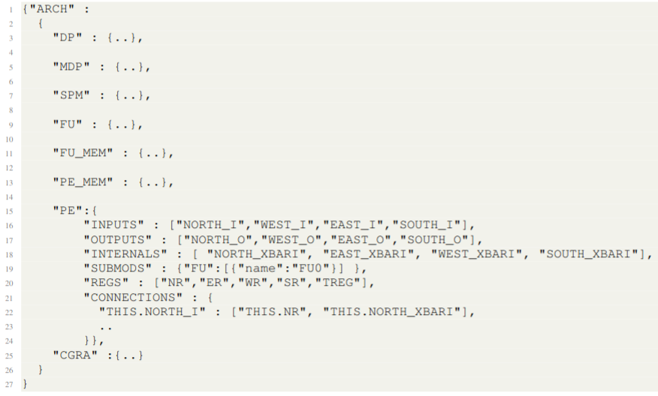
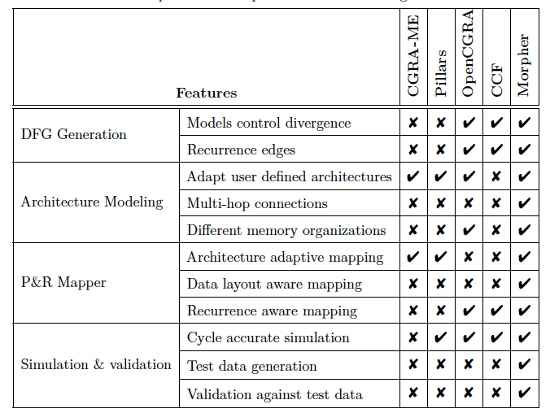
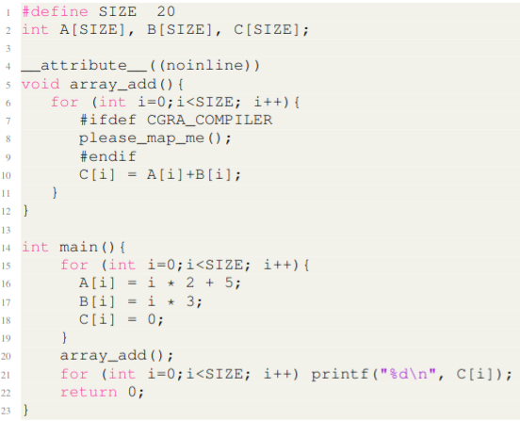
Morpher Open-Source CGRA Toolchain
Config. Memory
Only comprehensive end-to-end software development framework for CGRAs with compiler, testing and validation capability, simulation, emulation, and hardware generation.
Portable, scalable compiler providing best quality mapping & reducing compilation time from days to minutes.
PE
PE
PE
PE
DATA MEMORY
N
N
PE
PE
PE
PE
R
E
ALU
E
PE
PE
PE
PE
Switch
Switch
R
W
DATA MEMORY
W
RF
PE
PE
PE
PE
S
`
S
Abstract
Architecture Model
Basic
Modules(Chisel)
Dataflow Graph
DFG Generation
CGRA
Mapper
Hardware
Generator
Application
source code
with annotated kernel
6
SPM Data Layout
Test
Data Generation
Test data
Mapping
Configurations
Verilog RTL
Simulation
FPGA
Emulation
Area & Power
Estimation
https://github.com/ecolab-nus/morpher

Slide 12
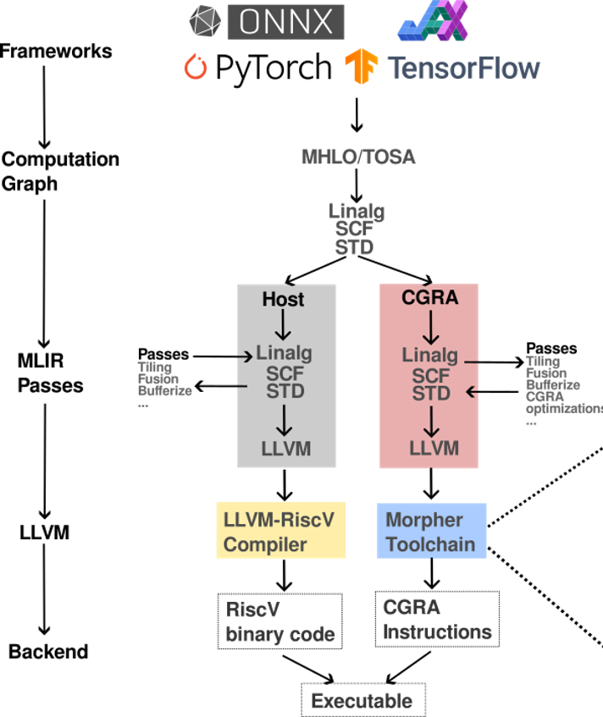
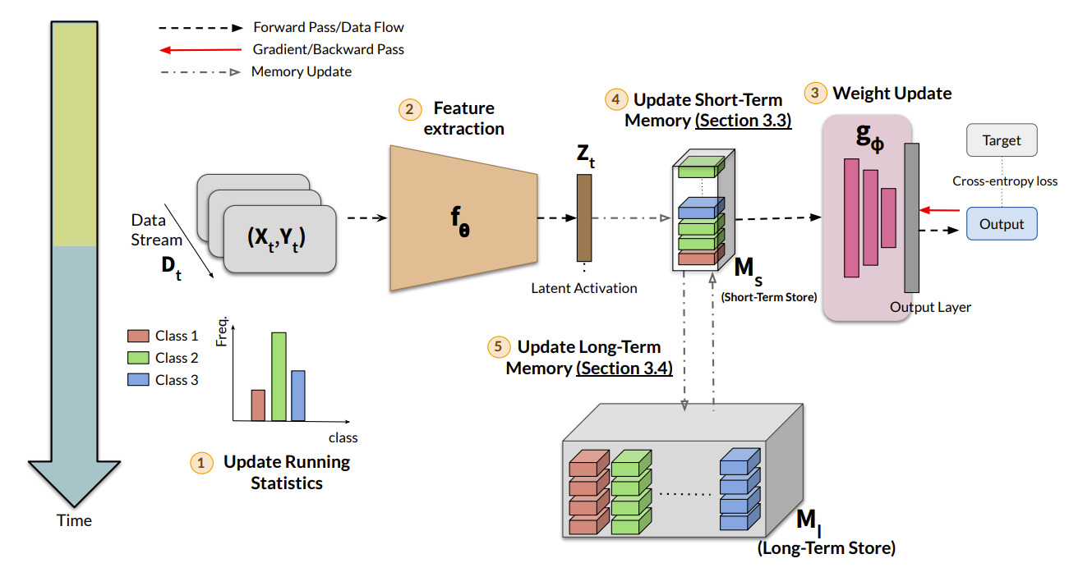
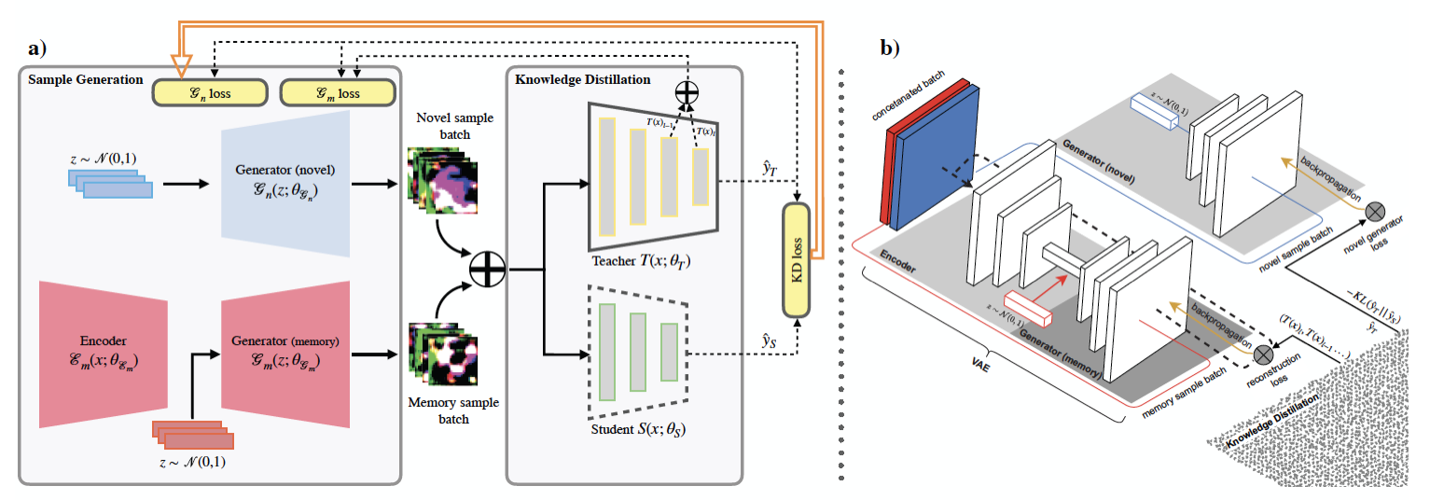
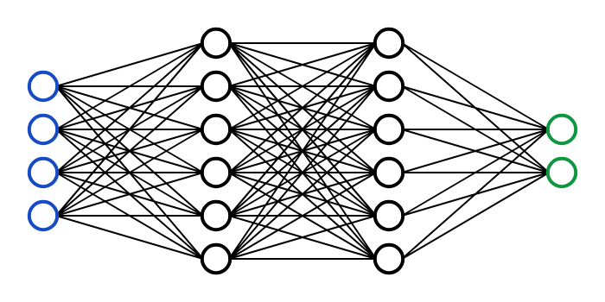
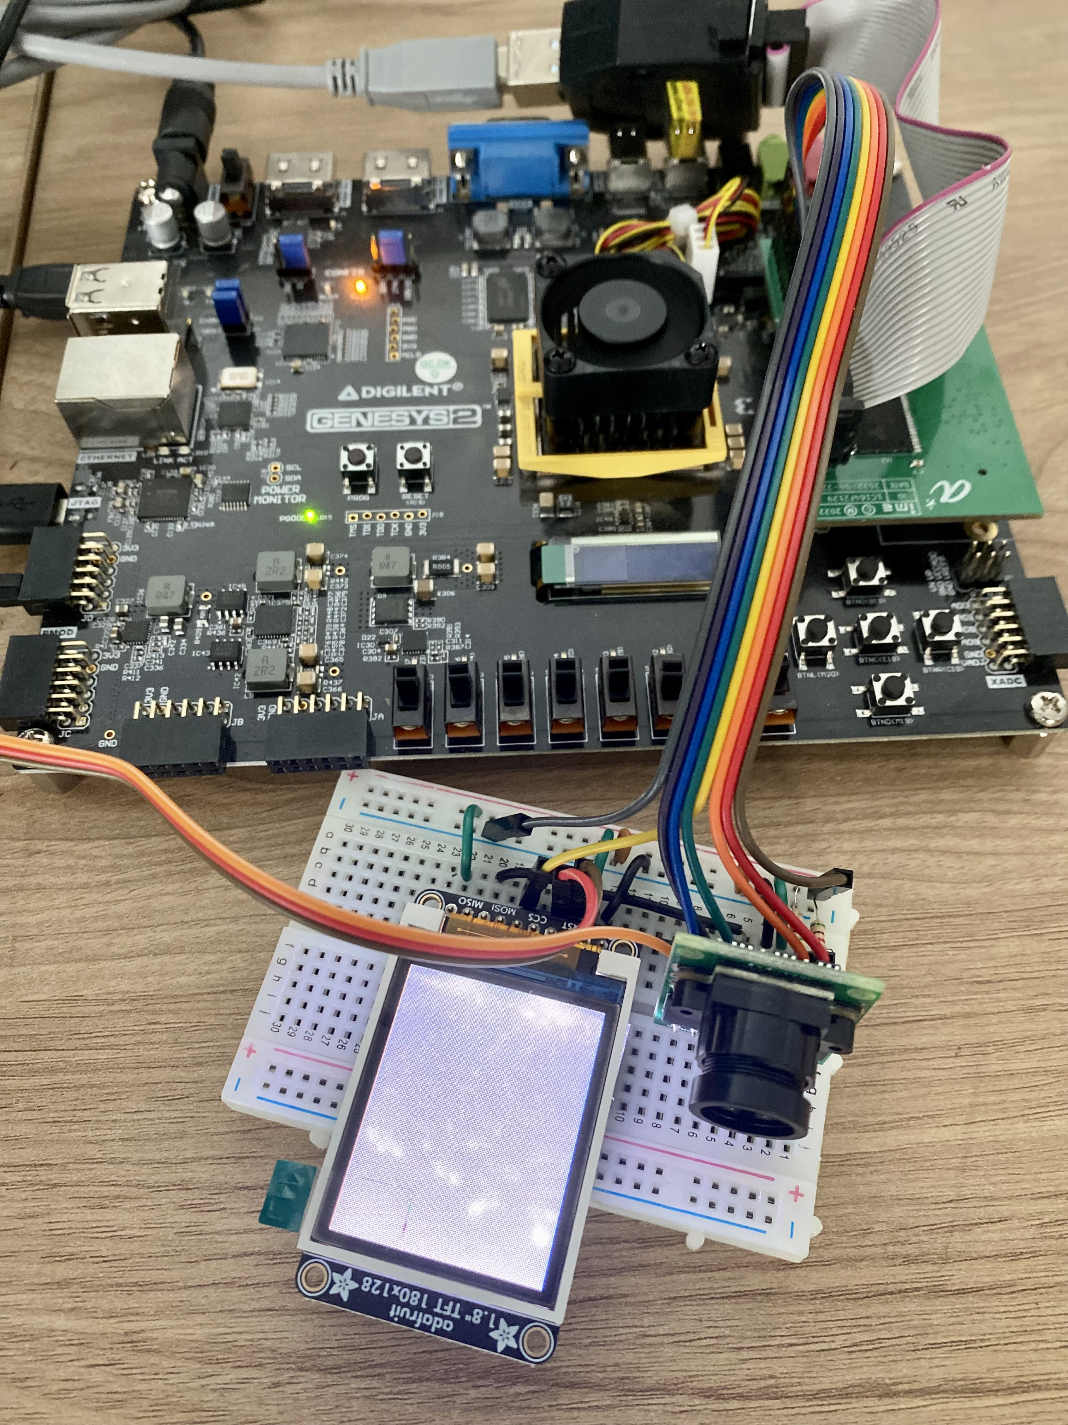

Edge AI Acceleration
Compress large ML models (deep neural networks) to smaller models for inference on edge devices through robust data-free knowledge distillation (AAAI 2022), class-aware pruning and on-device learning (DATE 2023), as well as quantization
End2End framework that connects ML frameworks with Morpher toolchain to map complex applications on heterogeneous system (RISC-V + CGRA)
Automated mapping and execution on PACE accelerator (RISC-V + CGRA)
Gesture recognition application

Slide 13
PACE Hardware Design
System-on-chip
Objective:
Design & implement coarse-grained reconfigurable array (CGRA) architecture for IoT computation workloads
Project Deliverables:
FPGA-based demonstration/Verification of RTL design
2 tape-outs: TC1 (Homogeneous PE array for neural network & loops) & TC2 (Heterogeneous PE array with customized circuits for ULP mixed reality analytics )
PACE CGRA specifications:
All data paths are 16-bit wide.
Consists of an 8×8 array of PEs
A total of 64KB CGRA data memories, each 8KB dual port SRAMs.
Integrated within a RISC-V SoC for seamless data and instructions transfer
RISC-V based CPU
SDRAM core
16KB D$
16KB I$
512KB on-chip SRAM
Interconnects
CGRA
8×8 PE array
8x8KB data memory (DM)
Peripheral subsystem
CGRA
8KB DM
PE
PE
…
PE
PE
8KB DM
PE
PE
…
PE
PE
8KB DM
PE
PE
…
PE
PE
8KB DM
PE
PE
…
PE
PE
CGRA Controller
8KB DM
PE
PE
…
PE
PE
8KB DM
PE
PE
…
PE
PE
8KB DM
PE
PE
…
PE
PE
8KB DM
PE
PE
…
PE
PE
CGRA Integrated in SoC

Slide 14
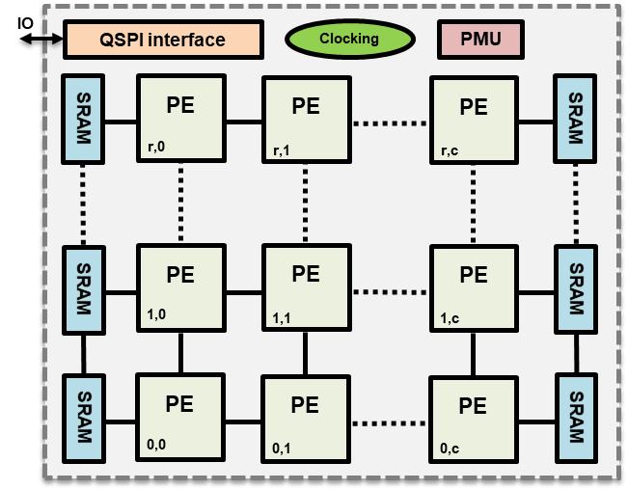
PACE-V SoC Architecture
PACE-V SoC is a RISC-V based IoT processor with embedded CGRA for accelerating computing workload on Edge devices.
The SoC is built in 40nm ULP for, aiming for high energy efficiency with rich communication interface (see on the right) and large on-chip SRAM to avoid off-chip memory access.
The system clock can be supplied by either an integrated PLL (upto 400 MHz) or a 100 MHz off-chip crystal.
We’ll discuss the details of 4 main blocks in the next few slides
 | PACE SoC Specifications
Core and peripheral | Tech. Node | UMC 40nm ULP
 | Supply Voltage | 1V/3.3V
 | Processor | RISC-V CPU (5 stage Rocket Core)
 | Primary memory | Micron MT48LC64M4A2 SDRAM (32MB)
 | Supported Comm. | GPIO×16, SD card, SPI×4 & UART
 | Debug | JTAG
 | On-chip SRAM | 512 KB
 | System clock freq. | 400/200/100 MHz
 | Core power | 14mW @ 1.0V
 | iCache/dCache | 16KB / 16KB
 | Custom bootloader | Yes, external EEPROM
 | Operating Temp. | 0⁰C - 85⁰C
PACE HW | Number of PEs | 8x8
 | PACE max clock freq. | T_{SIP}, 100 MHz
 | Data memory | 8 x 8KB dual-port SRAM
 | Instruction set | 17, including NoP
 | Config memory | 64 x 0.25KB single-port SRAM
 | Interface | AXI MIMO (32 bits)
Memory
Fabric
4
Micron
SDRAM
Chip (32MB)
RISC-V
CPU
Memory
Controller
1
SDRAM controller
Onchip SRAM
MMIO Fabric
GPIO
LED
DIP
Bootloader
ROM + FW
RF
Cache
IO Ports
UART
JTAG
SPI
HC05
BT v4
CPU Debug
Module
SD
AXI4 Memory Slave Mux
ADC
I2C
2
Clock Root
AES
PACE
SD Card
(4GB)
3
CLK REF
PLL
RNG
PACE
Controller
I2C
ROM
(8KB)
Notes:
To finalize this slide with critical details and specs. Use this link as template
1. To confirm the off-chip clock reference.
2. To check the power consumption for core and pads
3. To align the power supply for core and PACE

Slide 15
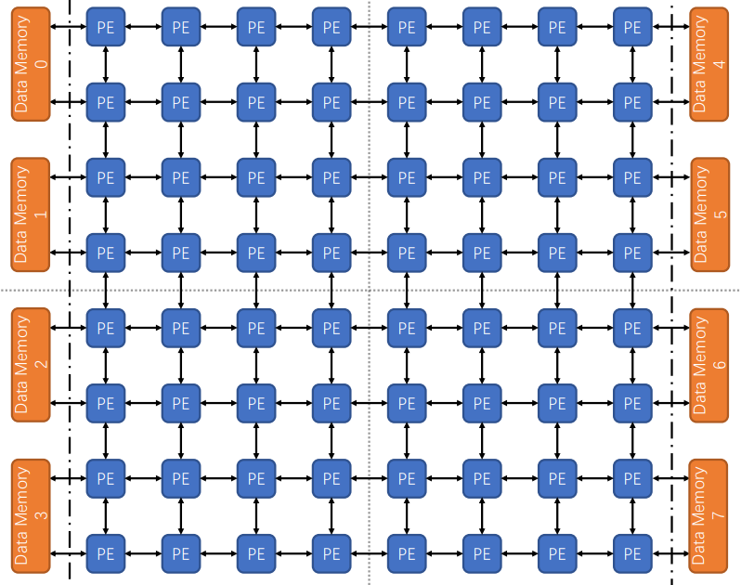
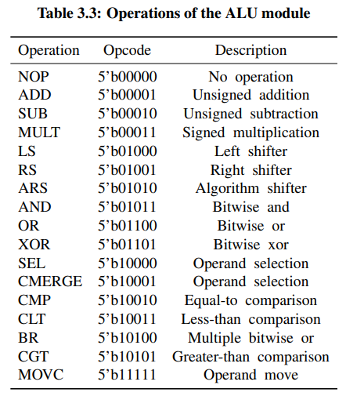
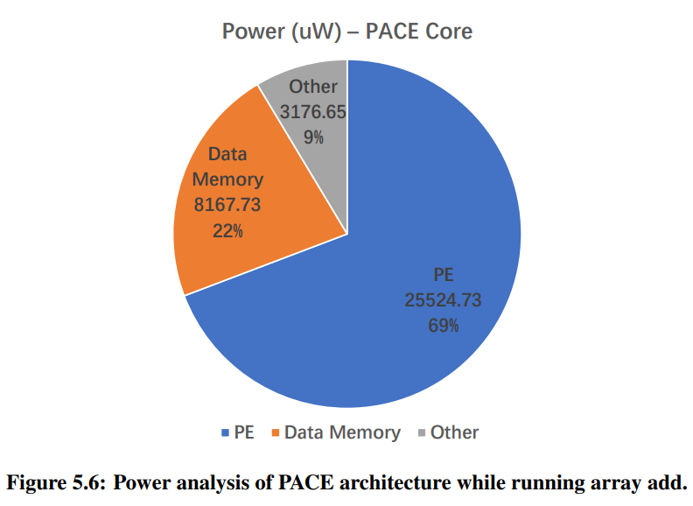
PACE CGRA Architecture
8×8 PE with 8 dedicated data memories. Each data memory will serve a group of 2×4 PEs.
Each PE supports 17 instructions with 16-bit data (including NOP).
All work at 100 MHz at nominal operation voltage of 1V.
Individual PE can be statically turned off via the PACE controller or dynamically turned off using NOP opcode
Equivalent to 166 TOPS/W (assuming 1 OPS & 1V supply)
Notes:
SW Layers Architecture

Slide 16
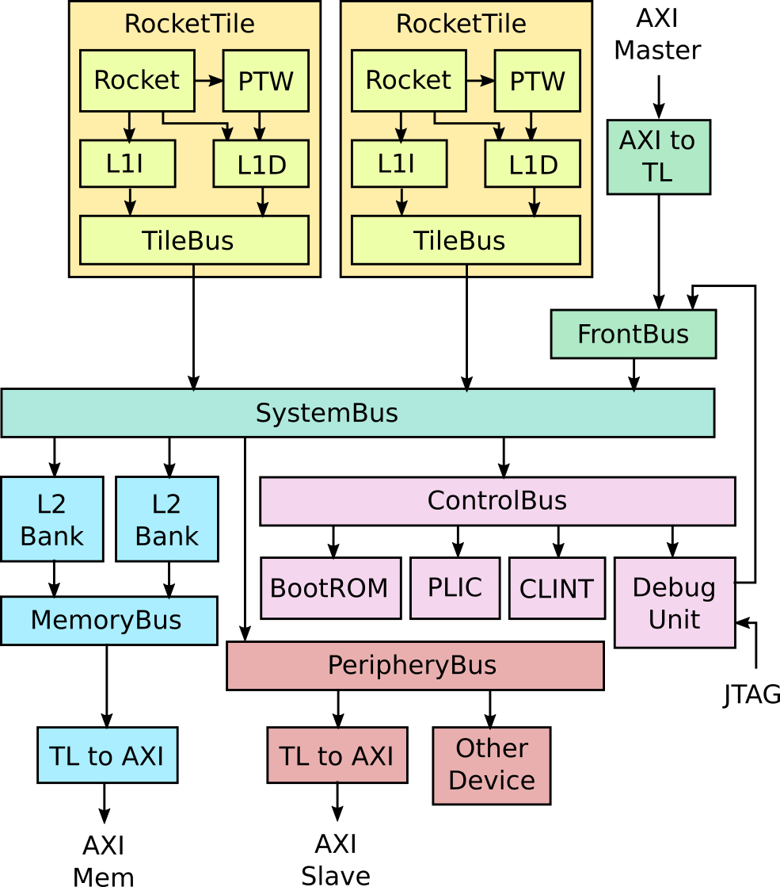
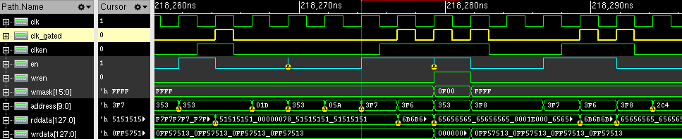
Rocket CPU
RISC-V CPU parameters:
Max frequency: 400MHz
Single core CPU (5 Stages, RV32IMAFC variant with FPU).
Single memory bus cached interface (AXI4 - SDRAM/SRAM).
Single periphery bus interface (AXI4 - Devices).
Instruction Cache: 16KB (1/3 of CPU area)
Data Cache: 16KB (1/3 of CPU area)
RISC-V CPU extended customizations:
Customized low hardware footprint boot ROM (269 bytes).
Clock gating mechanism for cache memories (2-3mW reduction).
Attached 1ms interrupt core for RTOS support.
Updated interrupt controller to support 6 IRQ lines (for SPI, I2C, etc)
High speed JTAG debug support (>30MHz) programmable IO pin drive strength coupled with onboard FT2232 chip.
Rocket Core System Architecture
Customized CPU Cache Clock Gating Circuitry
Notes:
SW Layers Architecture

Slide 17
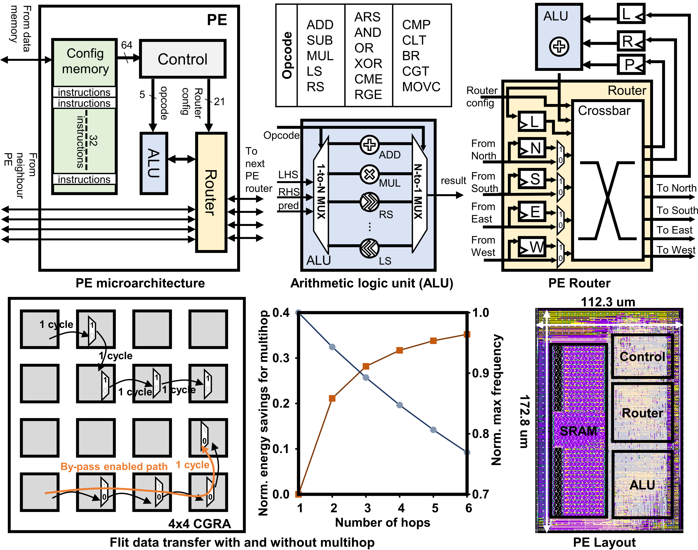
PACE CGRA PE Microarchitecture
The PEs consists of:
Can hold 32 x 64-bit instructions
An arithmetic logic unit (ALU)
A register-file based configuration memory
A configurable router with a bypass-able registered interface to support multihops
The ALU supports 17 operations
Has arithmetic, shift and Boolean instructions.
Supports control divergence and recurrence edges using comparator (CMP) and branching (BR) opcodes.
NOP instruction added for better power savings

Slide 18
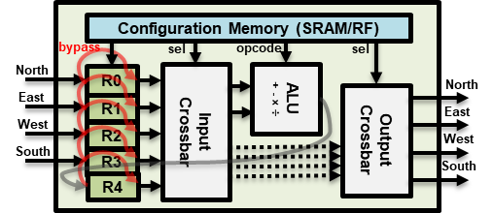
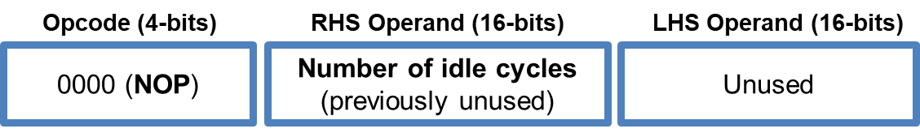
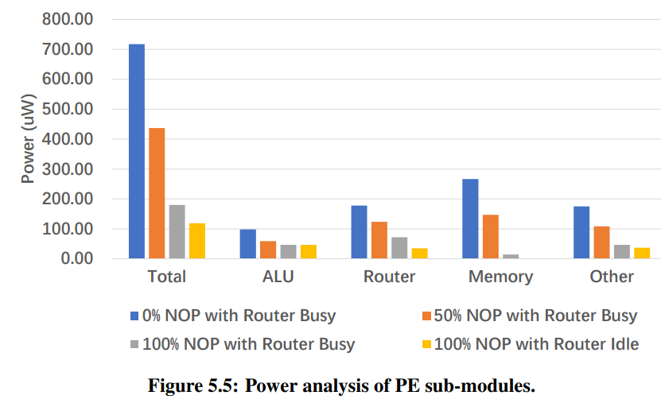
PACE Idle State Implementation (Tile)
Idle state implementation:
NOP (no-operation) is opcode 0.
Opcode operand should include how many idle/NOP cycles is needed, to allow for accurate clock gating counter logic.
Clocked units:
Router/Crossbar (if bypass not enabled)
Various registers: start_exec_shifted, prev_cycle_p_i2_i1, operands, etc.
Notes:
Logic that translates the address into the PE mem must not be gated at the n-1 cycle of the idle state.
Turning the clock off for some registers may lead to unexpected behavior, that may require debug & fine tuning.

Slide 19
PACE Idle State Implementation (Tile)
Functional steps:
The idle state logic unit waits for the tile to receive a NOP instruction.
The RHS operand is decoded as the number of idle cycles.
If RHS > 0, then the clock is immediately turned of via the clock gate.
Once the counter has reached the RHS value, the counter is reset and the clock is resumed.
Note: This feature can be disabled via NOP with operand 0.
Opcode (4-bits)
RHS Operand (16-bits)
LHS Operand (16-bits)
0000 (NOP)
Number of idle cycles (previously unused)
Unused
Logic Only
Ungated Clock
Gated Clock
ALU
Clock
Gate
clk_g
Routing
Regs
NOP
clk
clk_g
Opcode
LHS
cgen
RHS
clk_g
Tile Regs
Opcode
Idle State Logic
clk
1
clk_g
Config Mem (RF)
 | Old Tile | New Tile
Area | 11346.962 | 11453.225 (+2%)
Cell Count | 2080 | 2121 (+2%)
idle
2
cen
cycles
Counter
Area Difference
Idle State Circuitry

Slide 20
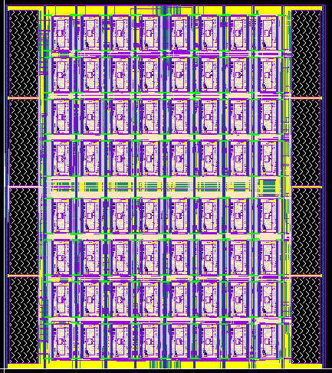
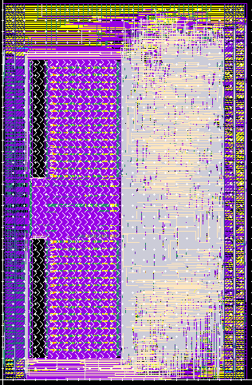
PACE Accelerator Layout
Layout of PE of the PACE
Layout of PACE
4 Dual-port SRAM
PEs in an 8x8 array
4 Dual-port SRAM
Router
SRAM
172.8 um
1,852 um
ALU
112.3 um
1,631 um
Notes:
To consider a more regular layout

Slide 21
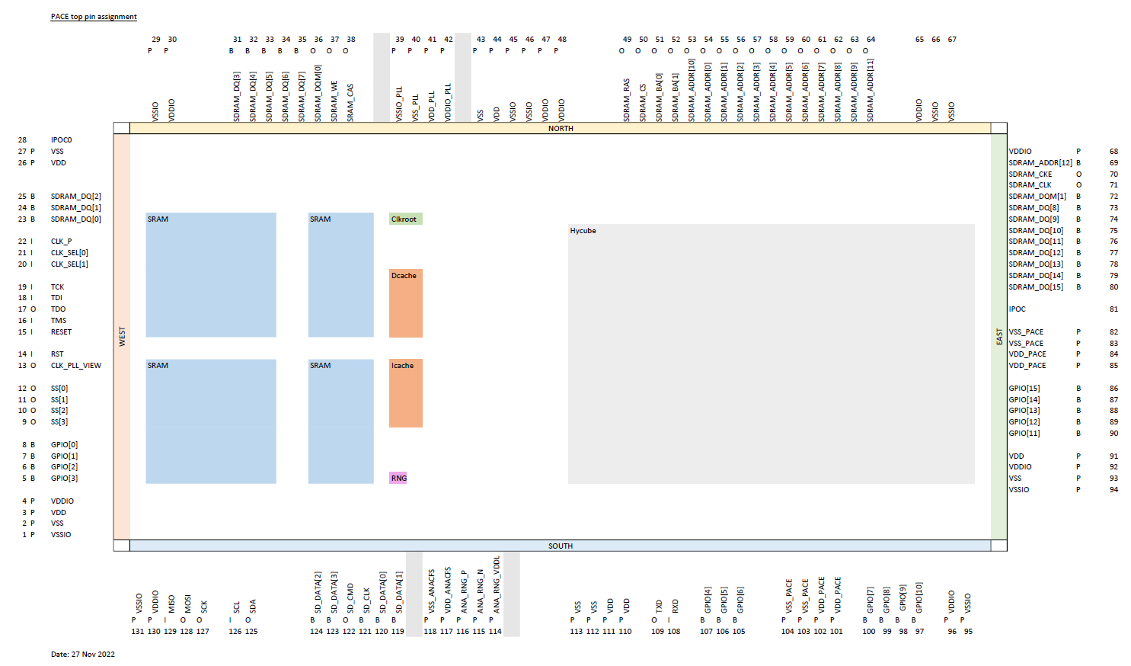
Updated IO planning
12 mm
Side | #pads | #signals | #power pads | Power
North | 39 | 24 | 15 | Core, IO, PLL
South | 37 | 20 | 17 | Core, IO, RNG, PACE
East | 27 | 18 | 9 | Core, IO, PACE
West | 28 | 22 | 6 | Core, IO
Total | 131 | 84 | 47
Bond wire min length: 6.3 mm
QFP144
3.96 mm
Our chip
2.4 mm
12 mm
Each side has (144/4)=36 bonding sites
The pad arrangement takes into account that:
Pin sequence of external drivers such as SD and SDRAM
Maximum #bonding site at all sides
Most power pads are placed at the edges of the die
#VDDIO/VSSIO pairs to provide enough power for driving external devices
In total 131 pads, hence QFP144 package is planned
Notes:
Reconsider pad allocations to fit in the package.

Slide 22
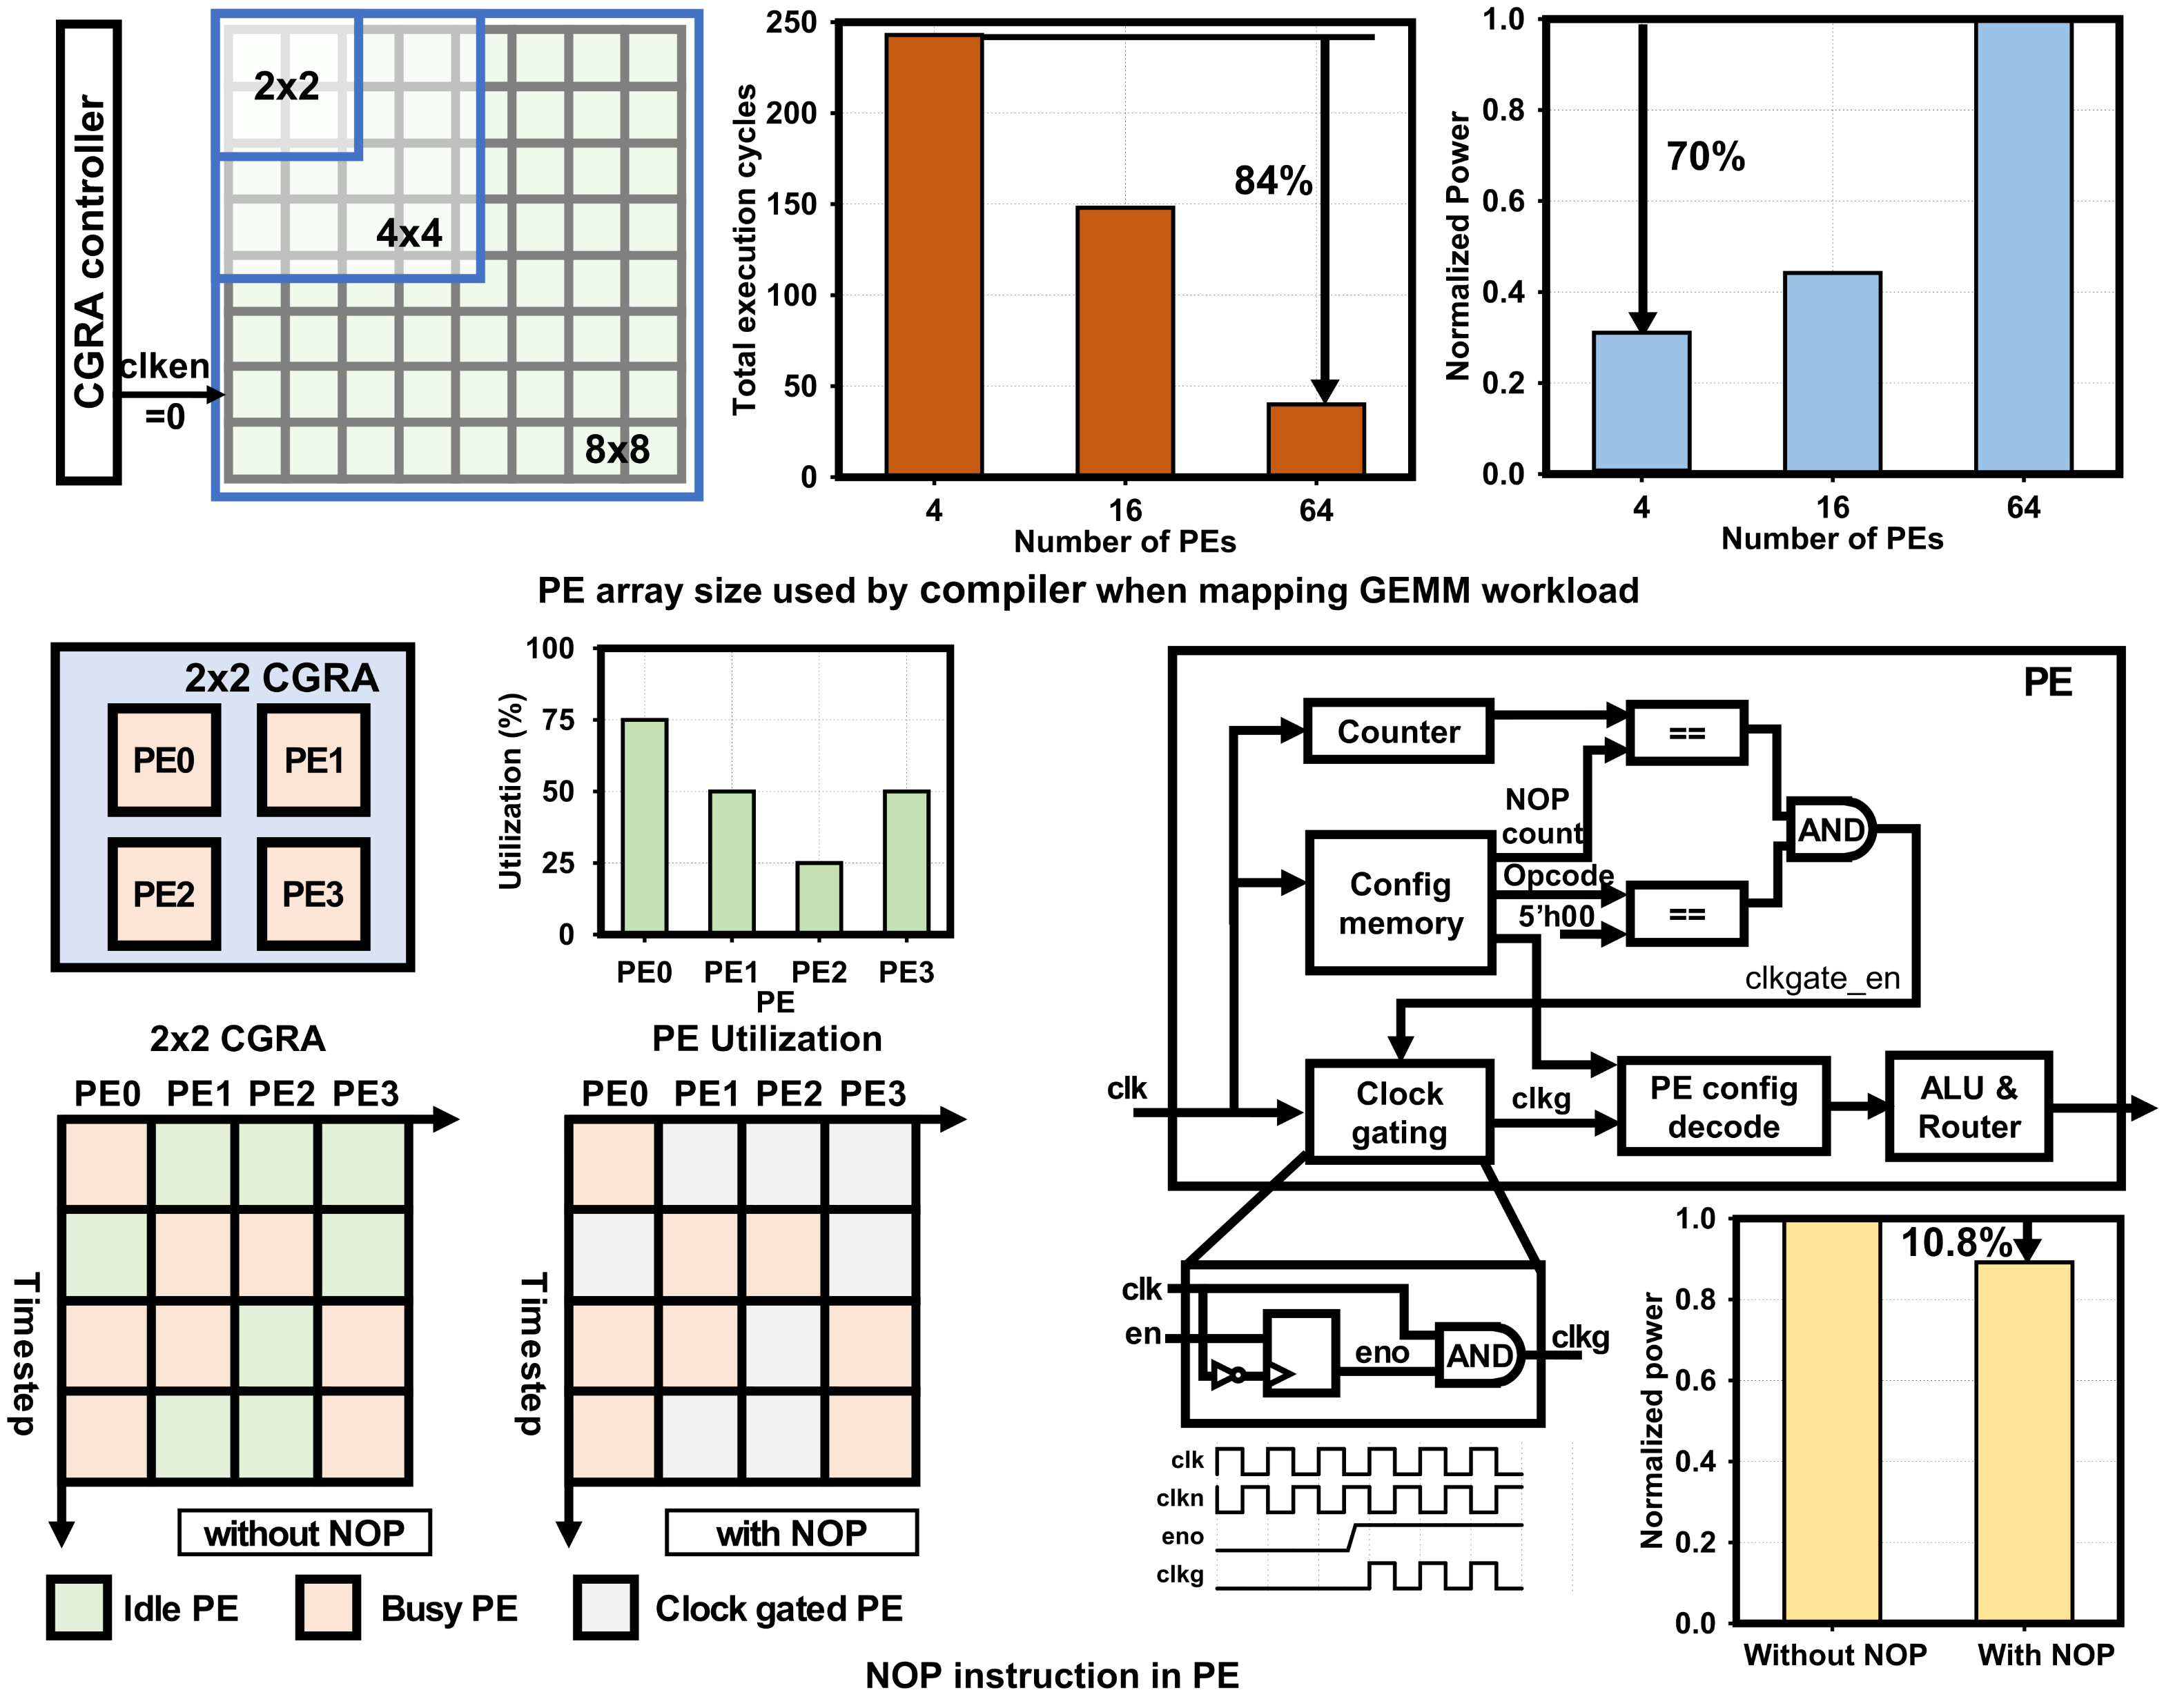
Static and dynamic clock gating
Static clock gating can be applied when inactive PEs are known beforehand
The power savings can be reduced by 70%
Dynamic clock gating is enabled by the NOP instructions
A PE can save 10.8% of powers when executing NOP

Slide 23
PACE SoC Verification Architecture
Testbench (tb_top)
Standardized TB architecture:
Summary: Minimal effort TB sim development work.Tests will just load the compiler generated traces into the memories and simulate the chip.
Predefined DUT macro and connections to avoid mistakes.
Uniform TB driver sequences.
RW tasks for data injection, eg. QSPI transacions, config/data memory loading sequences.
Main test sequence is test dependent.
All tests can be power profiled.
Data
Pins
DUT (macro)
Clocks
Resets
TB Driver
Init/
Done
Main test sequence
RW Tasks (svh include)
DUT Functions/
Tasks
Stop criteria
Timeout

Slide 24
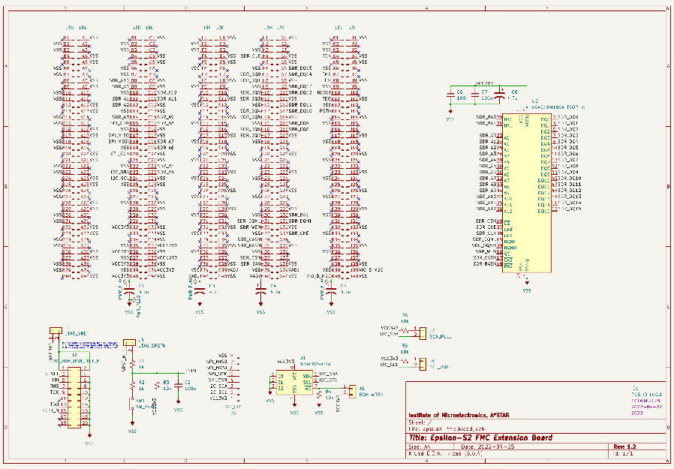
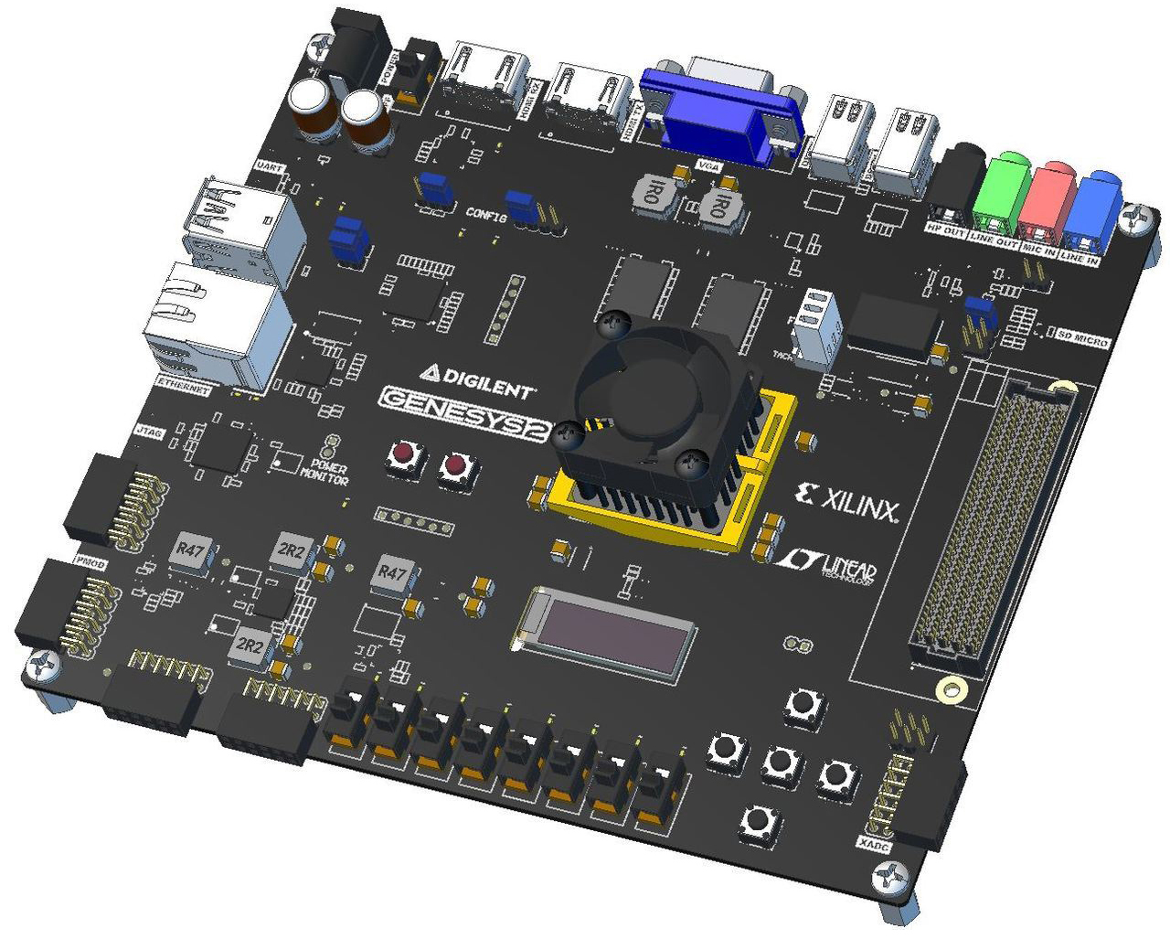
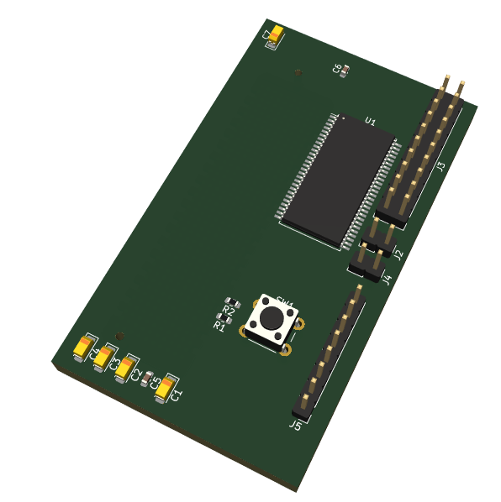
FPGA-based Verification Platform
Digilent Genesys 2 features:
On-board FPGA: Xilinx Kintex-7™ FPGA (XC7K325T-2FFG900C)
Selectable IO voltage (1.8V-3.3V)
Micro SD card connector
Fully-populated 400-pin FMC HPC connector w/ ten GTX lanes
USB-UART Bridge
128x32 pixel OLED
16-bit VGA connector
10/100/1000 Ethernet PHY
1GB 1800Mbps on-board DDR3
Dedicated USB port for JTAG programming and data transfers
Customized Epsilon-S2
extension PCB to closely
emulate final chip
Epsilon S2 extension PCB:
400-pin FMC connector
SDRAM chip
I2C EEPROM chip
Reset pushbutton
JTAG headers
I2C/SPI/QSPI headers

Slide 25
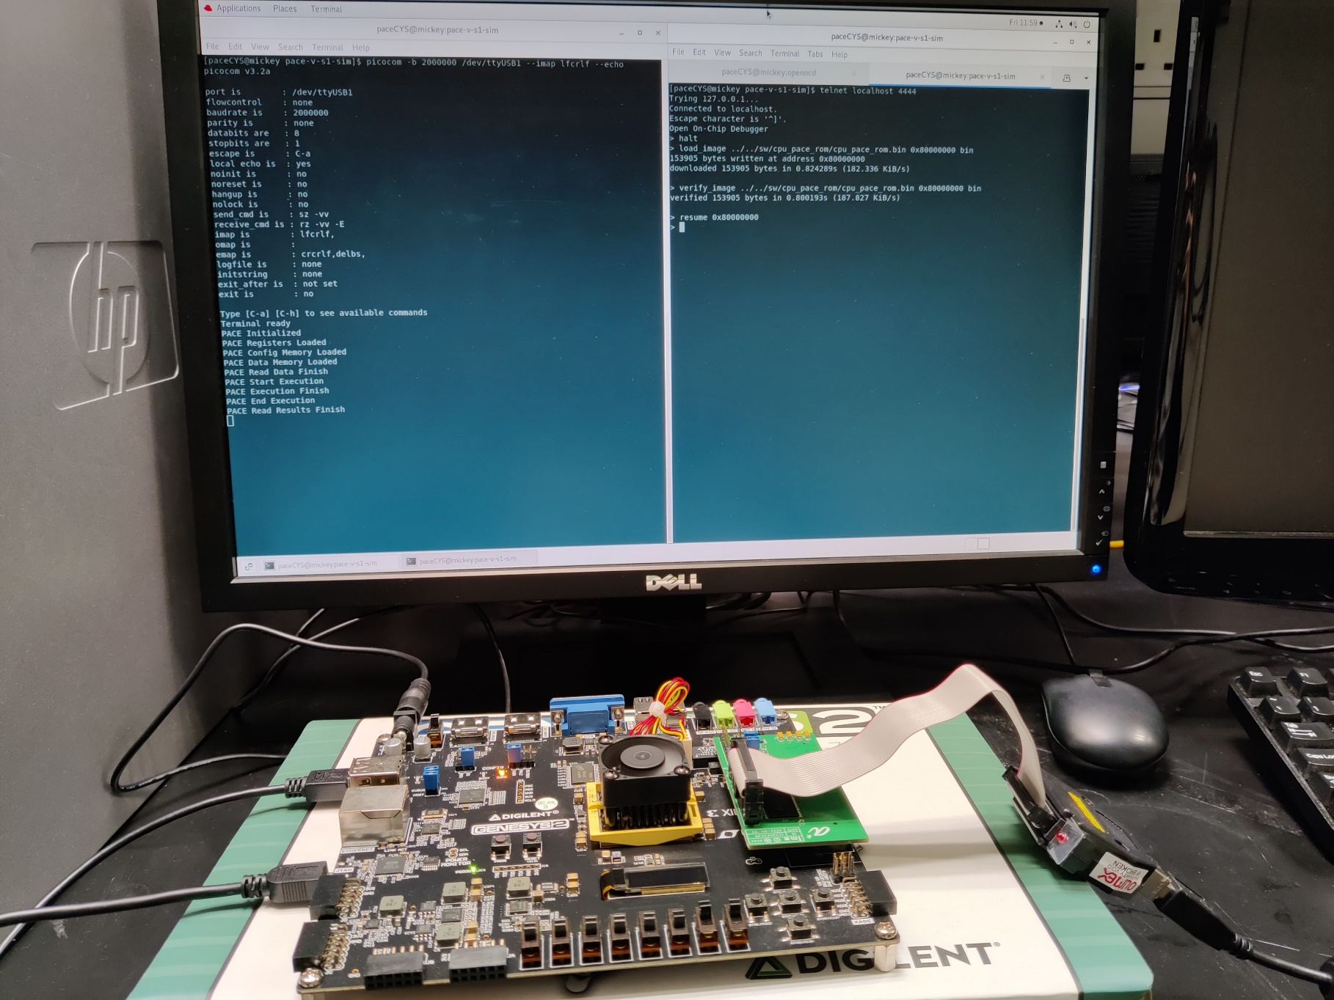
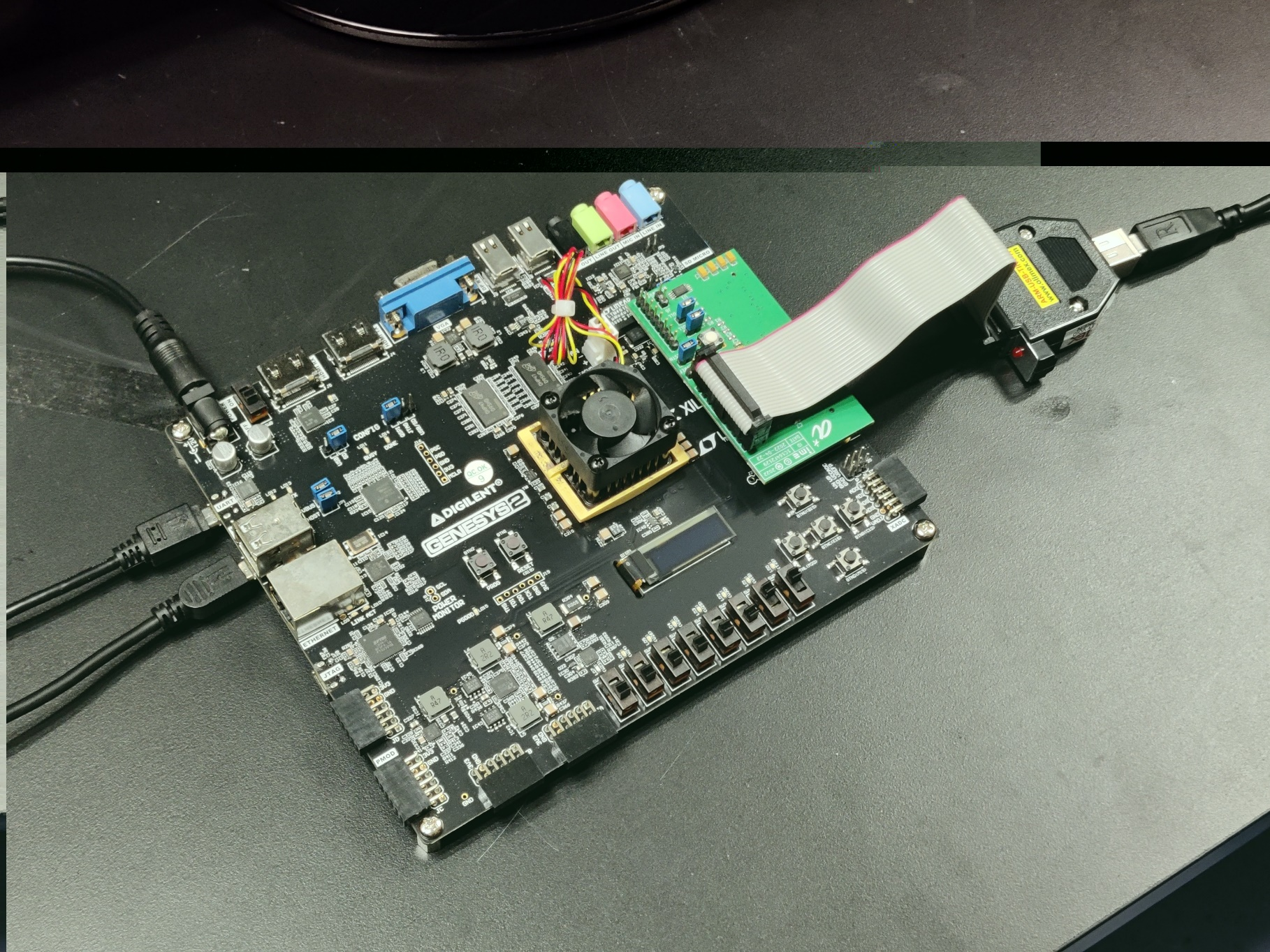
FPGA emulation setup
The PACE design coupled with a RISC-V CPU is synthesized and run on a FPGA board successfully
The PACE CGRA can run computation successfully
JTAG connection to RISC-V based controller
Power
PACE run results printed on screen
UART
FPGA JTAG

Slide 26
Test chip assembled on PCB for testing
The PACE SoC is taped out in UMC40nm process node and is assembled on PCB
3.96mm
RISC-V based controller
CGRA data memory
8x8 PE array
CGRA data memory
2.4 mm
Chip micrograph
PACE assembled on PCB board
Test laptop, oscilloscope and the PCB board

